Slide 1
KAGGLE GEEKS
Harish Kumar Reddy G
ReddyRani P
Mohamad Ali S
Manjula L
Niveda C

Slide 2
Predicting Hospital Readmission For patient With Diabetes

Slide 3
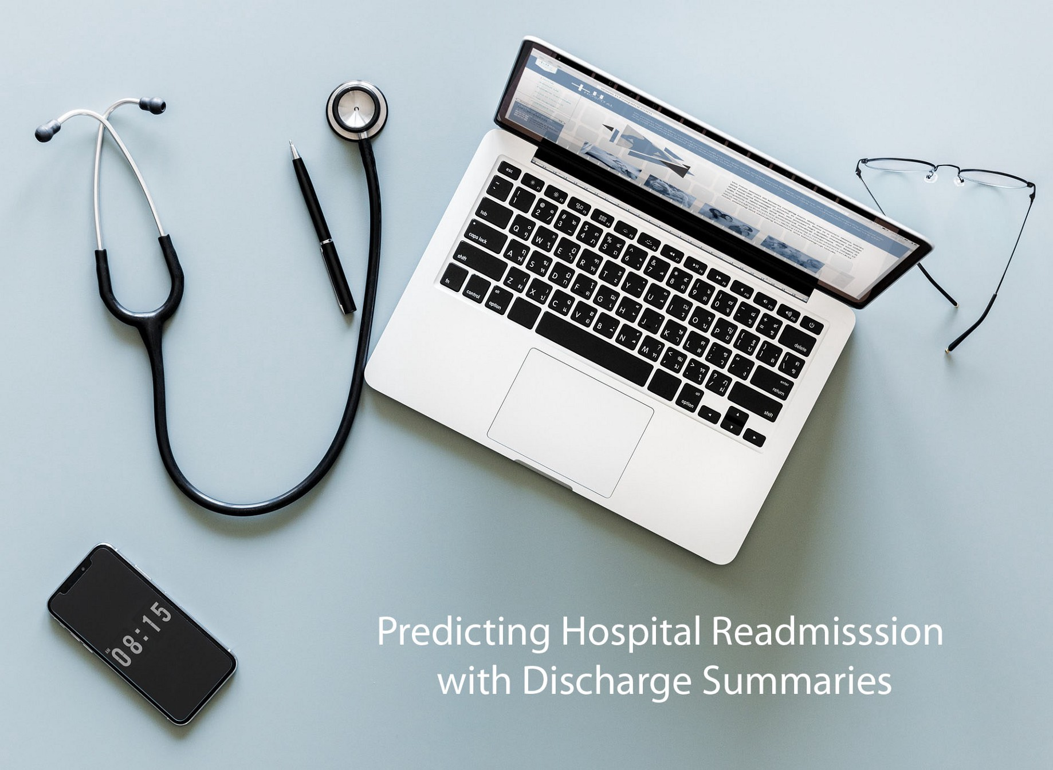
Introduction
A hospital readmission is when a patient who is discharged from the hospital, gets re-admitted again within a certain period of time.
Hospital readmission rates for certain conditions are now considered an indicator of hospital quality, and also affect the cost of care adversely.
The aim is to improve quality of care for patients and reduce healthcare spending by applying payment penalties to hospitals that have more than expected readmission rates for certain conditions
Machine learning helps in providing more accurate predictions than current practices.

Slide 4
Info
Python 3
Libraries:- Pandas,Numpy,seaborn
Implementations
I) Logistic Regression
II) Random Forest
III) ANN

Slide 5
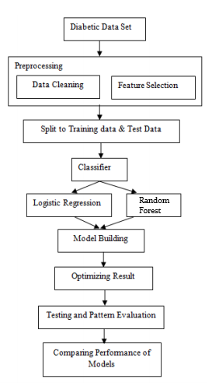

Slide 6
Model Prediction
Importing Dataset
data exploration
feature engineering
building training/validation/test samples
model selection
model evaluation

Slide 7
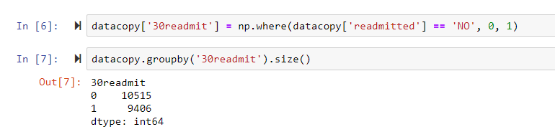
The most important column here is readmitted, which tells us if a patient
was hospitalized within 30 days, greater than 30 days or not readmitted.

Slide 8

Logistic Regression
Logistic regression is a traditional machine learning model that fits a linear decision boundary between the positive and negative samples. This linear function is then passed through a sigmoid function to calculate the probability of the positive class. Logistic regression is an excellent model to use when the features are linearly separable. One advantage of logistic regression is the model is interpretable — i.e. we know which features are important for predicting positive or negative. One thing to consider is that the modeling is sensitive to the scaling of the features, so that is why we scaled the features above. We can fit logistic regression using the following code from scikit-learn.

Slide 9
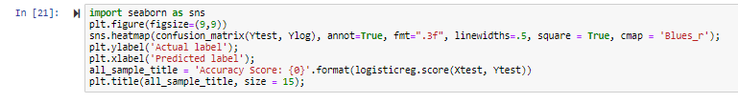
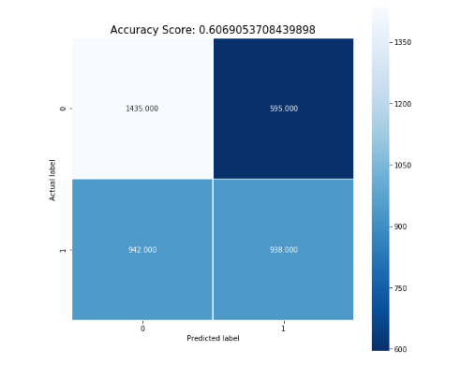
Seaborn

Slide 10
Conclusion
Through this project, we created a machine learning model that is able to predict the patients with diabetes with highest risk of being readmitted within 30 days. The best model was a logistic regression..

Slide 11
Thank You

